Slide 1
Digital Portfolio
STUDENT NAME: THARUN SP
REGISTER NO AND NMID: autunm11024ca119
DEPARTMENT: B.C.A
COLLEGE: DRBCCC HINDU COLLEGE/ MADRAS UNIVERSITY

Slide 2
PROJECT TITLE
PORTFOLIO FOR WEB DEVELOPEMENT

Slide 3


AGENDA
Problem Statement
Project Overview
End Users
Tools and Technologies
Portfolio design and Layout
Features and Functionality
Results and Screenshots
Conclusion
Github Link
3/21/2024 Annual Review

Slide 4

PROBLEM STATEMENT
Difficulty in showcasing personal skills effectively
Traditional resumes lack interactivity & design appeal
Need for a modern, responsive digital portfolio

Slide 5

PROJECT OVERVIEW
Personal portfolio website for SP Tharun
Responsive, interactive, and user-friendly
Highlights skills, projects, and achievements

Slide 6

WHO ARE THE END USERS?
Recruiters & Hiring Managers
Potential Clients & Collaborators
Tech community & peers

Slide 7

TOOLS AND TECHNIQUES
HTML5 – Structure of the website.
CSS3 – Styling and responsive design.
JavaScript – Interactivity (form validation, animations).
Git & GitHub – Version control and project hosting.
VS Code – Development environment.

Slide 8
POTFOLIO DESIGN AND LAYOUT
Header – Name, tagline, navigation menu.
Sections – About, Skills, Projects, Contact.
Projects Section – Showcases real examples with descriptions.
Footer – Social links (LinkedIn, GitHub, Email).
Responsive Layout – Works on both desktop and mobile.
8

Slide 9
FEATURES AND FUNCTIONALITY
Smooth scrolling navigation.
Responsive design for mobile & desktop.
Interactive project cards.
Contact form with validation.
Integrated social media & GitHub links.
Simple and clean UI for better user experience.

Slide 10
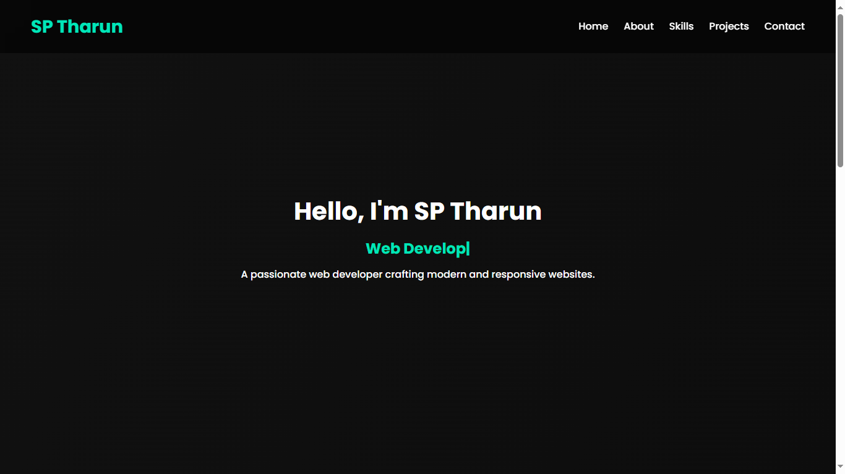

RESULTS AND SCREENSHOTS
3/21/2024 Annual Review
10

Slide 11
CONCLUSION
Professional portfolio successfully built
Enhances online visibility & branding
Provides room for future upgrades
11

Slide 12
Github Link
https://github.com/masstharun685-cmyk/TNSDC-FWD-DP.git

